Slide 1
SIT374: Project Management
Lecture 10: Project Execution/closure and review

Slide 2
Project management process groups (PMBOK)
Approved Project Management Plan
Completion Report
Monitoring
Initiation
Planning
Executing
Closing
Control
Approved Project Charter
Customer signoff

Slide 3
Project Execution Phase
A project management plan is a document coordinating all planning documents and helping guide project’s execution and control.
Your project management plan has been approved, now what?!
The majority of time on a project is usually spent on execution, as is most of the project’s budget.

Slide 4
1. Acquiring, Developing & Managing Team
You might have started with few team members and available resources, now what?
You need to acquire or assign personnel to your project. Have you got your project skills matrix? who knows what?
Have you hired the right team? can they work together?

Slide 5
Tuckman Model
Forming: Introduction of team members at the initiation phase
Storming: occurs as team members have different opinion as to how the teams should operate.
Norming: is achieved when team members have developed a common working method, and co-operation and collaboration exists
Performing: occurs when the emphasis is on reaching the team goals, rather than working on team process
Adjourning: involves the break up of team after they have successfully reached their goals and completed the work
Training/team-building can be designed to facilitate team development.

Slide 6
1. Managing Team – Conflict MGMT (Cont’d)
Key strategies to handle conflict management:
Confrontation: face a conflict using a problem-solving approach
Compromise: a give-and-take approach, win-win
Smoothing: avoid areas of differences & emphasizes areas of agreement
Forcing: win-lose strategy, my way, or high way!
Withdrawal: avoidance, withdraw from an actual or potential disagreement
Collaboration: incorporate different views to develop consensus/commitment.
Confronting is the most effective, while withdrawal is least desirable
Notes:
Bulls eye and organizational structure

Slide 7
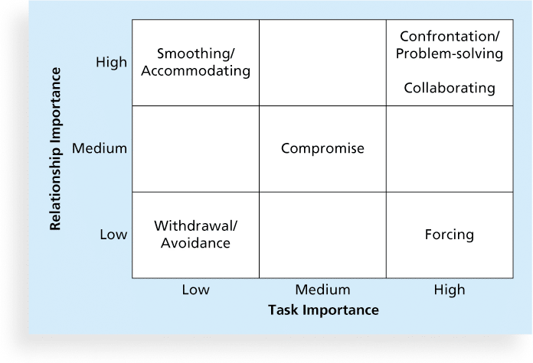
Conflict management strategies

Slide 8
2. CONDUCTING PROCUREMENTS
Plan and prepare documents and selection criteria
Advertise to potential sellers
Supplier conference
Quotes or proposals received
Source selection
Contract

Slide 9
3. Quality Assurance (QA)
Activities undertaken to satisfy requirements of project (i.e., satisfy quality measures)
Benchmarking comparing specific project practices or product characteristics to those of other projects or products
Quality audit a structured review of specific quality management activities that help identify lessons learned and that could improve performance on current or future projects

Slide 10
4. Controlling Stakeholder Engagement
Engage with stakeholders
Manage their expectations (record it, communicate it and execute it)
Capture & resolve concerns…issue log & timely status updates
Communicate, communicate, communicate…
Issue log — a document used to help track and resolve issues on projects.
Change request – what needs to be changed in the current project cost/time/cost

Slide 11
5. Direct & Manage Project
Make sure that the team is doing the work described in the project management plan
What’s your main input?
Approved project management plan
Approved change requests
Tools: Expert judgment, Software systems (MS Project)
Project Deliverables, Project Execution Information, Plan Updates

Slide 12
6. Communicate – Distribute Information
Project communication plan (what information/when/how)
Project status report: describes where the project stands at a specific point in time.
Project progress report: describe what the project team has accomplished during a certain period
Project forecast: predict future project status and progress based on past information and trends

Slide 13
Project Monitor and control Phase
You developed the project plans. This is your project baseline.
Now, do you think your project will follow the plan? Is your plan final?
Change will happen – Be prepared and don’t freak out!
Scope? Time? Cost? Quality? Risk?
What is the process to control the change?
Who should approve/authorize changes? Change Control Board

Slide 14
Project Monitor and Control
PM&C processes take place in parallel with project execution, to observe project execution.
The objective of PM&C is to identify potential project problems in a timely manner and take corrective action, when necessary, to control the execution of the project.
The project is observed and measured regularly against the project plan to ensure that the project is within acceptable variances of cost, schedule and scope, and that risks and issues are continually monitored and corrected as needed.

Slide 15
Integrated Change Management
Identifying, evaluating, and managing changes throughout the project life cycle.
Ensures that changes as a result of project corrective actions are managed across the project knowledge areas.
Change management/control process
Outputs include: Approved/Rejected change requests or defect repairs, Updates to the Project Management Plan

Slide 16
Validate Scope
Ensures that project deliverables are formally accepted...customer signoff
Remember scope creep
Outputs include: accepted deliverables, requested changes, recommended corrective actions

Slide 17
Scope Control
Ensures that changes to project scope are controlled through a well-defined change management process
Outputs include: Updates to the Project Scope Statement and Scope baseline, Updates to the Work Breakdown Structure (WBS) and the WBS Dictionary, Updates to the Project Management Plan

Slide 18
Schedule Control
Monitors and controls changes to the project schedule.
Outputs include: Updates to the schedule, updates to the Project Management Plan

Slide 19
Cost Control
Monitors and controls costs and changes to the project budget.
Outputs include: Cost estimate updates, Cost baseline updates, Performance measurements, Updates to the Project Management Plan

Slide 20
Perform Quality Control
The quality control performance process measures specific project results to determine whether the project is meeting quality standards.
Outputs include: Quality control measurements, Validated defect repair, Updates to the quality baseline, Updates to the Project Management Plan

Slide 21
Also Controlling
HR – Team Management - track team member performance, provide feedback, resolve issues and coordinate changes to maintain and improve project performance.
Communication - ensure the optimal flow of information throughout the entire project life cycle.
Risk - monitor identified and residual risks, identify new risks, carry out risk response plans, and evaluating the effectiveness of risk strategies.
Procurement - ensure that the seller’s performance meets contractual
requirements

Slide 22
REMEMBER: process groups
Approved Project Management Plan
Completion Report
Monitoring
Initiation
Planning
Executing
Closing
Control
Approved Project Charter
Customer signoff

Slide 23
Project Closure Phase
Involves gaining stakeholder and customer acceptance of the final products and services.
Update organizational process assets, such as project files and a lessons-learned report.
If project team members procured items during the project, they must formally complete or close out all contracts.
If the project stopped or terminated, you should still document lessons learnt

Slide 24
Review…

Slide 25
What should You expect in the exam?
NPV analysis
Critical Path Analysis Method (CPM)
EVM Problem
Key Project Lifecycle Phases & Key processes in each Phase
Key concepts in project management process groups
Project management knowledge areas

Slide 26
Project management process groups-Activity Map
Project Plan
Acquire & manage
team
Monitor &
Control Proj.
Project
Closing
Project Charter
Scope
Time
Cost
Quality
HR
Risk
Procurement
Stakeholders
Comm.
Stakeholders
Register
Scope control &
verification
Select Sellers &
POs
Contract
Closing
Schedule control
Progress Reporting
Perform QA
Manage Stakeholders
Comm.
Contract Admin
Initiation
Planning
Executing
Mon. & Con.
Closing

Slide 27
PM 10 Knowledge Areas
Scope
Time
Cost
Quality
Integration
HR
Comm.
Procure.
Risk
Stakeholder

Slide 28
General – Chapters 1/2/3
Project
Project Management
Project vs Program vs Portfolio Management
Project lifecycle and phases
Project management framework

Slide 29
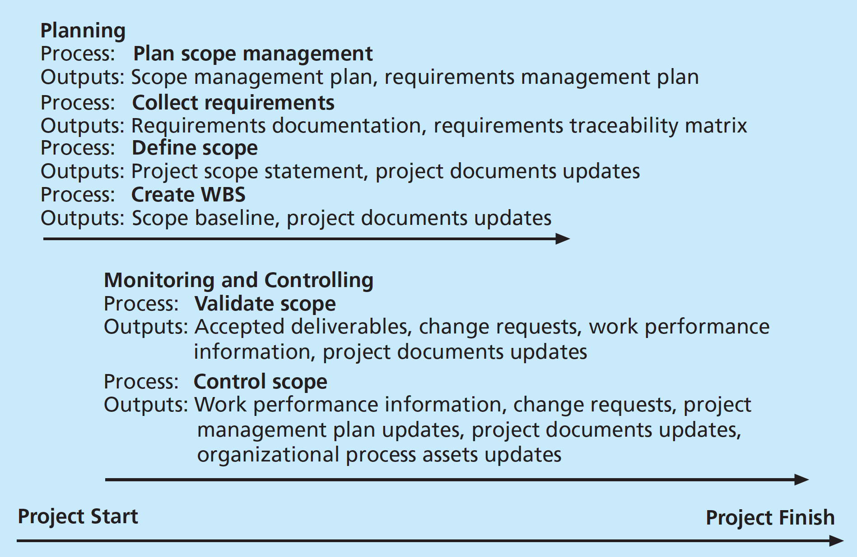
1. Scope Management
Scope Mgmt Plan
Scope statement
Requirements doc/How?
In/out of scope
WBS
WBS Dictionary
Scope baseline
Validate scope
Control scope
Scope creep
Deliverable
Decomposition
Top-down vs bottom-up

Slide 30
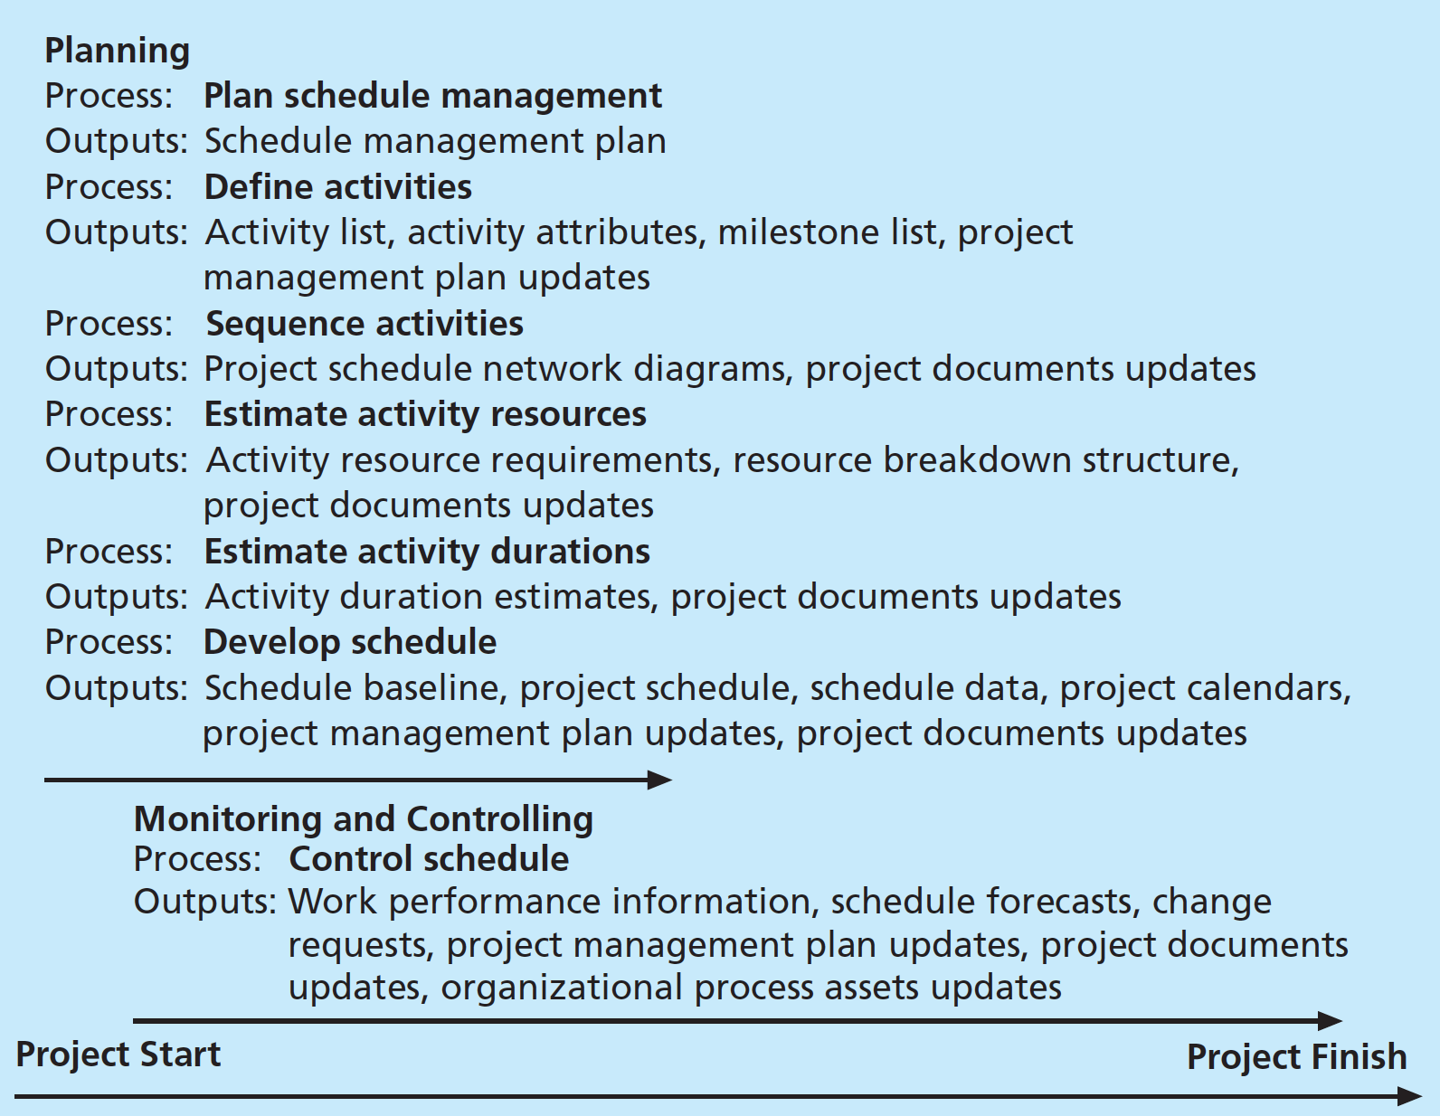
2. Time Management
Time management plan
Define activity
Sequencing
Resourcing
Duration
Schedule
Control schedule
CPM
Network Diagram
Tracking Gantt chart
Milestone
Dependencies
PERT
Resource breakdown Structure

Slide 31
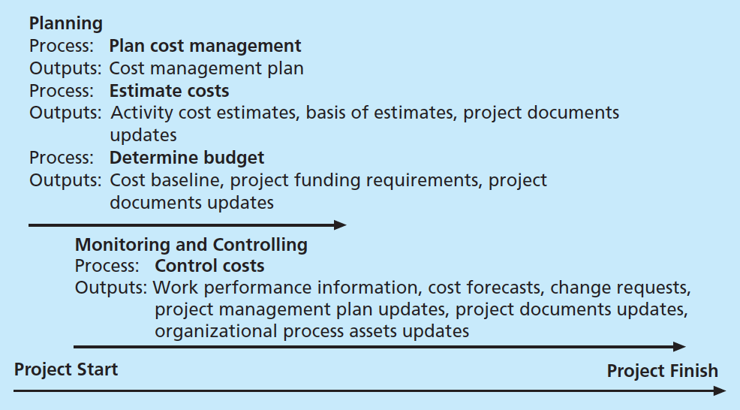
3. Cost Management
Cost mgmt plan
Estimate cost
Budgeting
Control cost
EVM/PV/EV/CPI/SPI
EAC/RP
- CV vs SV
- Is a given project on track?
Direct/indirect/sunk/
in-tangible/tangible
Management reserve

Slide 32
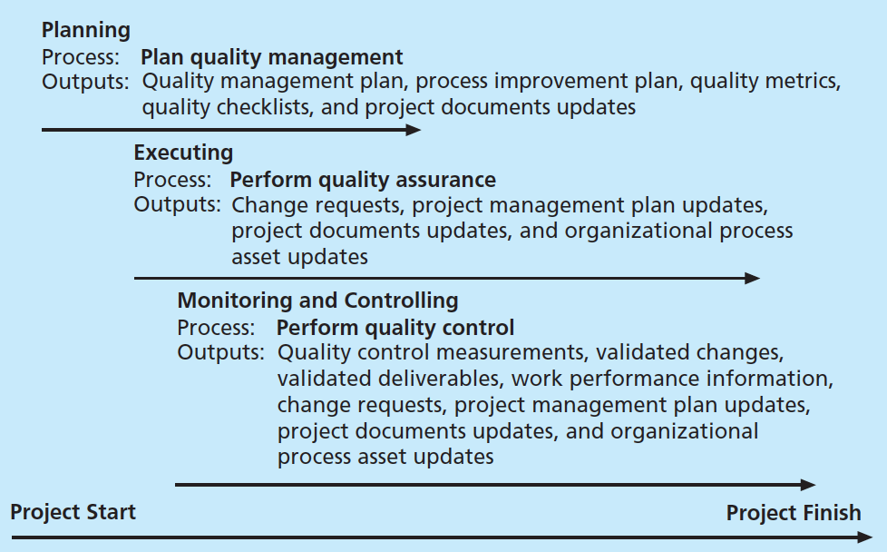
4. QUALITY Management
Quality?
QA vs QC
QC/ cause&effect diagram (fishbone)/ Pareto/control chart/testing/…
QA/ Quality audit

Slide 33
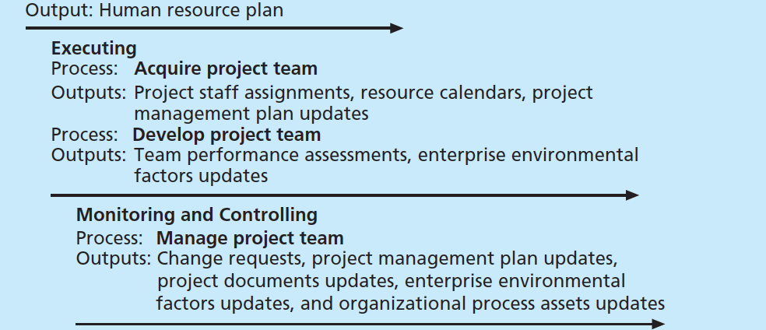
5. HR Management
Team dynamics (Tuckman model)
Maslow’s Hierarchy
Influence/Power/Authority
RACI chart
Resource histogram
Resource loading/Over allocation/ resource leveling
Conflict resolution

Slide 34
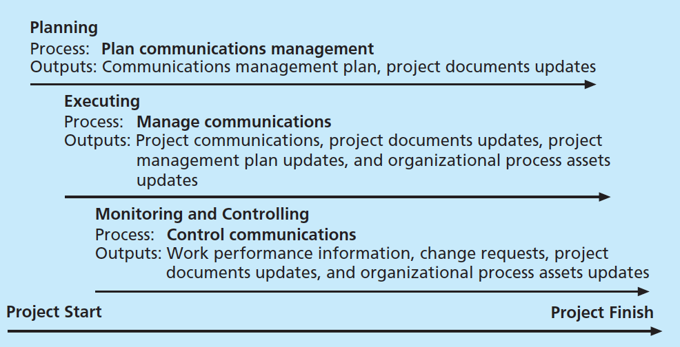
6. Communication Mgmt
Project Status vs Progress reports
Communication Plan
# of people vs # of comm channels
Formal vs informal communication

Slide 35
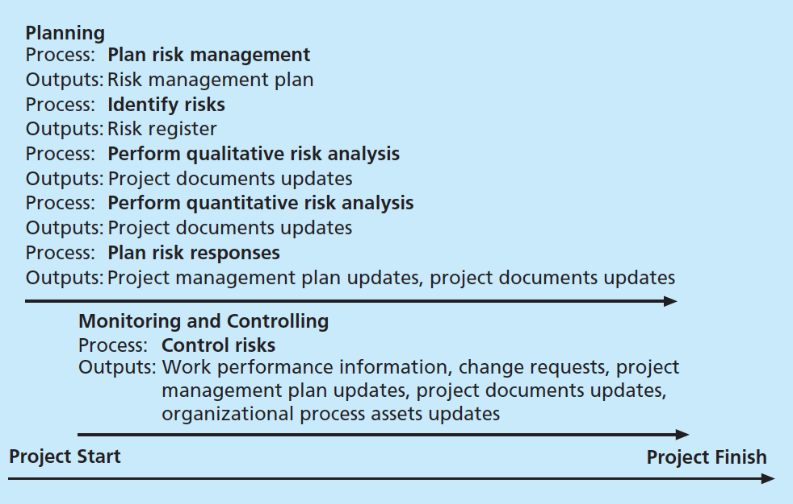
7. Risk MGMT
Risk mgmt plan
Negative vs positive risks
Contingency plans
Fallback plans
contingency reserve vs mgmt reserve
Risk breakdown structure
Risk Register
Risk identification [brainstorming/Delphi/..]
Risk owner
Qualitative vs quantitative/ techniques? Risk response?
Top 10 risks list
Monte-carlo simulation
residual risk vs secondary risk

Slide 36
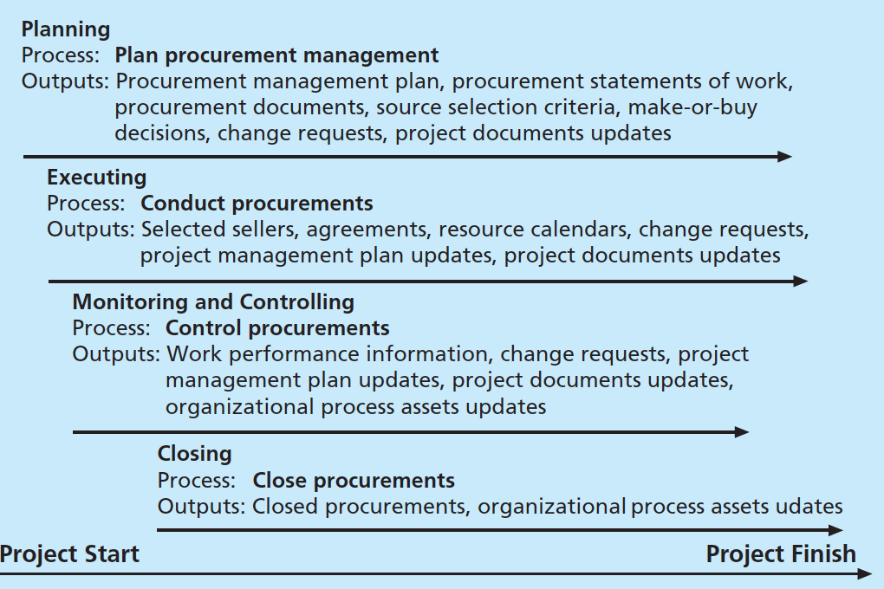
8. Procurement Mgmt
Contract/types/
buyer vs seller costing risk
Make-or-buy
Market research
Contract Statement of work
Request for proposal vs quotation/ bid/tender
Conducting procurement
Time and material

Slide 37
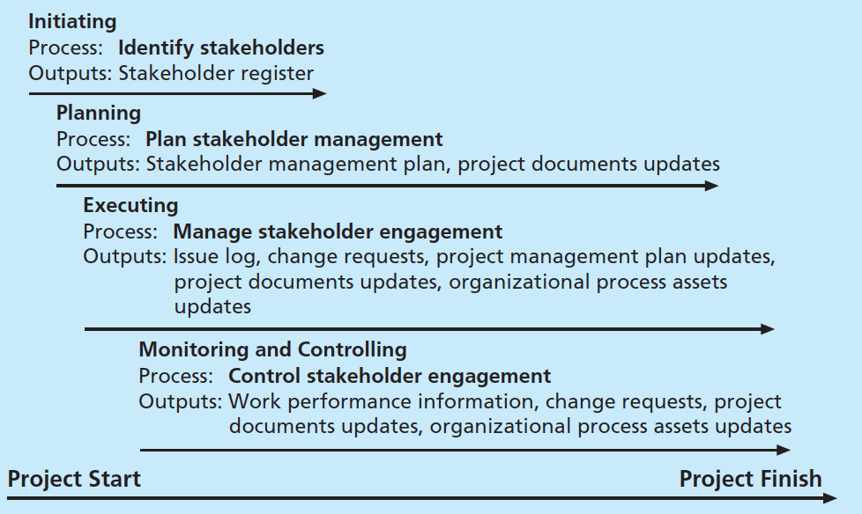
9. Stakeholder Mgmt
Stakeholder register
Stakeholder interest/power grid
Project issue log

Slide 38
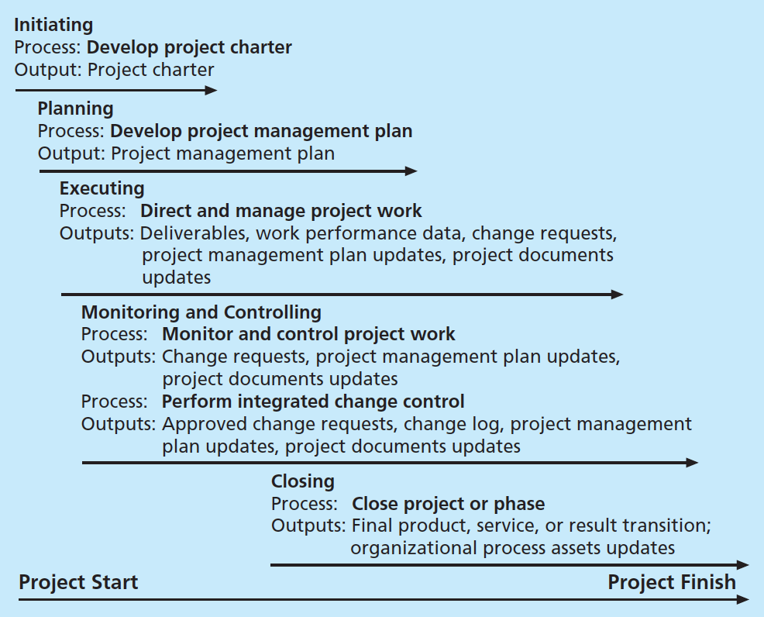
10. Integration Mgmt
Project charter
Project Management Plan
Integrated Change Control
SWOT Analysis
NPV/ROI/Payback
Weighted score model

